Slide 1
CHAPTER 2
ARRAYS AND STRUCTURES
All the programs in this file are selected from
Ellis Horowitz, Sartaj Sahni, and Susan Anderson-Freed
“Fundamentals of Data Structures in C”,

Slide 2
Arrays
Array: a set of index and value
data structure
For each index, there is a value associated with
that index.
representation (possible)
implemented by using consecutive memory.

Slide 3
ADT Array is objects: A set of pairs <index, value> where for each value of index there is a value from the set item. Index is a finite ordered set of one or more dimensions, for example, {0, … , n-1} for one dimension, {(0,0),(0,1),(0,2),(1,0),(1,1),(1,2),(2,0),(2,1),(2,2)} for two dimensions, etc. Functions: for all A ∈ Array, i ∈ index, x ∈ item, j, size ∈ integer Array Create(j, list) ::= return an array of j dimensions where list is a j-tuple whose ith element is the size of the ith dimension. Items are undefined. Item Retrieve(A, i) ::= if (i ∈ index) return the item associated with index value i in array A else return error Array Store(A, i, x) ::= if (i in index) return an array that is identical to array A except the new pair <i, x> has been inserted else return error end array *ADT 2.1: Abstract Data Type Array (p.52)
Notes:
Create ( 3, {5, 6, 7})
➔ 開出一個 3 維 array，大小是 5 x 6 x 7

Slide 4
Arrays in C
int list[5], *plist[5];
list[5]: five integers
list[0], list[1], list[2], list[3], list[4]
*plist[5]: five pointers to integers
plist[0], plist[1], plist[2], plist[3], plist[4]
implementation of 1-D array
list[0] base address = α
list[1] α + sizeof(int)
list[2] α + 2*sizeof(int)
list[3] α + 3*sizeof(int)
list[4] α + 4*size(int)
Notes:
實作 array 的部分

Slide 5
Arrays in C (Continued)
Compare int *list1 and int list2[5] in C.
Same: list1 and list2 are pointers.
Difference: list2 reserves five locations.
list1 = malloc (5*sizeof(int));
Notations:
list2 - a pointer to list2[0]
(list2 + i) - a pointer to list2[i] (&list2[i])
*(list2 + i) - list2[i]

Slide 6
Example: 1-dimension array addressing
int one[] = {0, 1, 2, 3, 4};
Goal: print out address and value
void print1(int *ptr, int rows)
{
/* print out a one-dimensional array using a pointer */
int i;
printf("Address Contents\n");
for (i=0; i < rows; i++)
printf("%8u%5d\n", ptr+i, *(ptr+i));
printf("\n");
}

Slide 7
call print1(&one[0], 5)
*Figure 2.1: One-dimensional array addressing (p.55)

Slide 8
Two-Dimension Arrays

Slide 9
Two-Dimension Arrays
int ** make2dArray(int rows, int cols)
{
int **x, i;
x = malloc (sizeof(int*), rows);
// x = malloc (sizeof(*x), rows);
for(i = 0; i < rows; i ++)
x[i] = malloc (sizeof(int), cols);
// x[i] = malloc (sizeof(**x), cols);
return x;
}

Slide 10
Structures (aka records)
struct {
char name[10];
int age;
float salary;
} person;
// create a variable whose name is person
strcpy(person.name, “james”);
person.age=10;
person.salary=35000;
Notes:
這樣是直接宣告一個變數名稱為 person

Slide 11
Create structure data type
typedef struct human_being {
char name[10];
int age;
float salary;
} humanBeing;
or
typedef struct {
char name[10];
int age;
float salary;
} humanBeing;
humanBeing person1, person2;

Slide 12
Embed a struct within a struct
typedef struct {
int month;
int day;
int year;
} date;
typedef struct {
char name[10];
int age;
float salary
date dob;
} humanBeing;

Slide 13
Unions
Similar to struct, but only one field is active.
Example: Add fields for male and female.
typedef struct {
enum tagField {female, male} gender;
union {
int children;
int beard;
} u;
} genderType;
typedef struct{
char name[10];
int age;
float salary;
date dob;
genderType genderInfo;
} humanBeing;
humanBeing person1, person2;
person1.genderInfo.gender=male;
person1.genderInfo.u.beard=FALSE;
person2.genderInfo.gender=female;
person2.genderInfo.u.children=4;

Slide 14
Self-Referential Structures
One or more of its components is a pointer to itself.
typedef struct {
char data;
struct list *link;
} list;
list item1, item2, item3;
item1.data=‘a’;
item2.data=‘b’;
item3.data=‘c’;
item1.link=&item2;
item2.link=&item3;
item3.link=NULL;
Construct a list with three nodes
item1.link=&item2;
item2.link=&item3;
malloc: obtain a node
a
b
c

Slide 16
Ordered List
ordered (linear) list: (item₁, item₂, item₃, …, item_{n})
(Sunday, Monday, Tuesday, Wednesday, Thursday, Friday, Saturday)
(Ace, 2, 3, 4, 5, 6, 7, 8, 9, 10, Jack, Queen, King)
(1941, 1942, 1943, 1944, 1945)
(a₁, a₂, a₃, …, a_{n-1}, a_{n})

Slide 17
Operations on Ordered List
Find the length, n , of the list.
Read the items from left to right (or right to left).
Retrieve the ith element.
Store a new value into the ith position.
Insert a new element at the position i , causing elements numbered i, i+1, …, n to become numbered i+1, i+2, …, n+1
Delete the element at position i , causing elements numbered i+1, …, n to become numbered i, i+1, …, n-1 array (sequential mapping)? (1)~(4) O (5)~(6) X

Slide 19
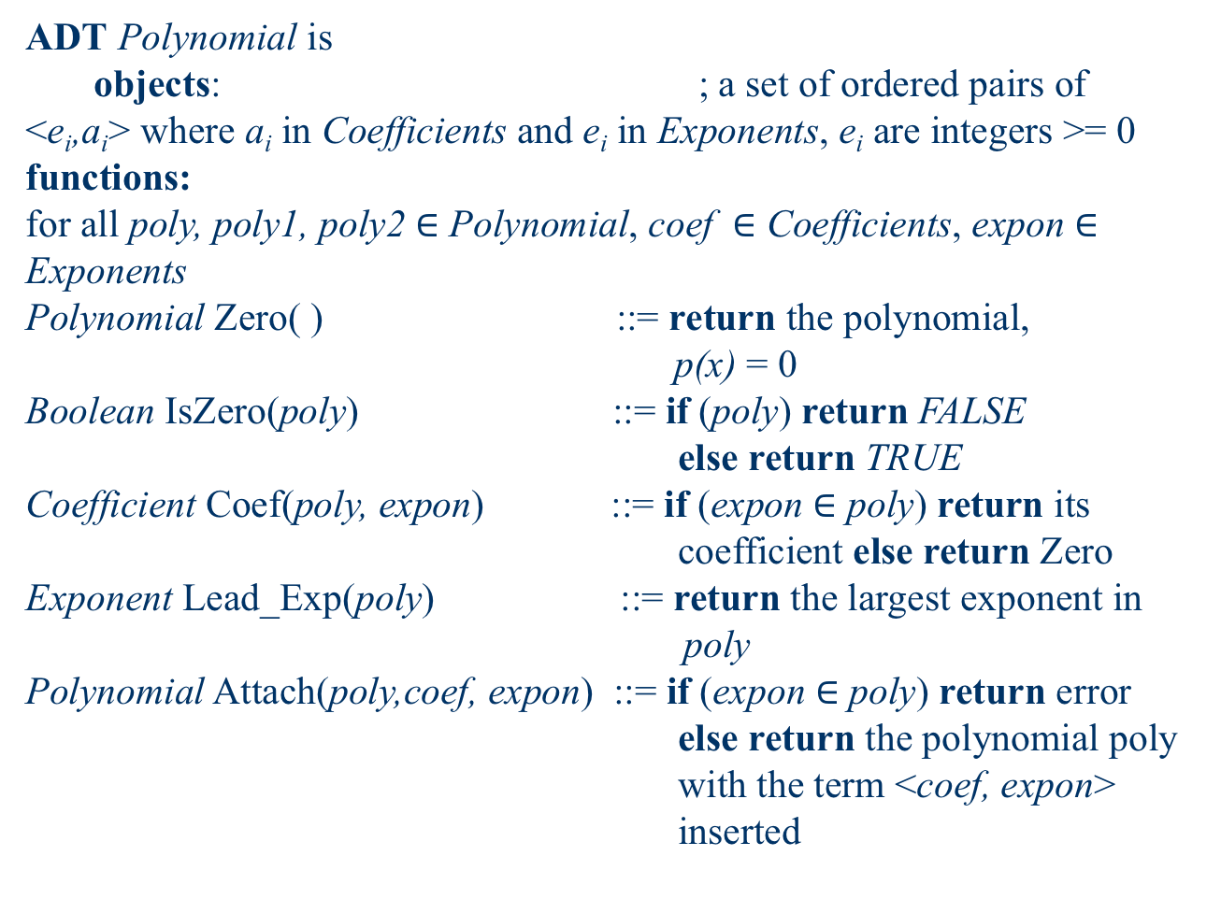
ADT Polynomial is objects: ; a set of ordered pairs of <e_{i},a_{i}> where a_{i} in Coefficients and e_{i} in Exponents, e_{i} are integers >= 0 functions: for all poly, poly1, poly2 $∈$ Polynomial, coef $∈$ Coefficients, expon $∈$ Exponents Polynomial Zero( ) ::= return the polynomial, p(x) = 0 Boolean IsZero(poly) ::= if (poly) return FALSE else return TRUE Coefficient Coef(poly, expon) ::= if (expon $∈$ poly) return its coefficient else return Zero Exponent Lead_Exp(poly) ::= return the largest exponent in poly Polynomial Attach(poly,coef, expon) ::= if (expon $∈$ poly) return error else return the polynomial poly with the term <coef, expon> inserted
Polynomials A(X)=3X²⁰+2X⁵+4, B(X)=X⁴+10X³+3X²+1
Notes:
提醒大家，ADT 是什麼意思
提醒大家，如何判斷一個結構寫得好不好，時間複雜度和空間複雜度的分析

Slide 20
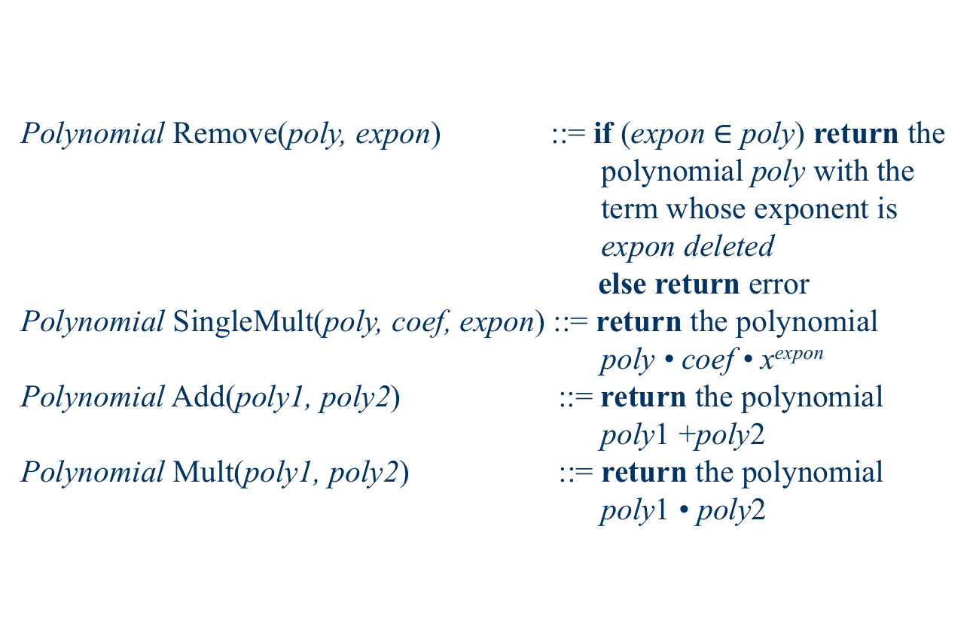
Polynomial Remove(poly, expon) ::= if (expon $∈$ poly) return the polynomial poly with the term whose exponent is expon deleted else return error Polynomial SingleMult(poly, coef, expon) ::= return the polynomial poly • coef • x^{expon} Polynomial Add(poly1, poly2) ::= return the polynomial poly1 +poly2 Polynomial Mult(poly1, poly2) ::= return the polynomial poly1 • poly2
End Polynomial
*ADT 2.2: Abstract data type Polynomial (p.67)

Slide 21
/* d =a + b, where a, b, and d are polynomials */ d = Zero( ) while (! IsZero(a) && ! IsZero(b)) do { switch COMPARE (Lead_Exp(a), Lead_Exp(b)) { case -1: d = Attach(d, Coef (b, Lead_Exp(b)), Lead_Exp(b)); b = Remove(b, Lead_Exp(b)); break; case 0: sum = Coef (a, Lead_Exp (a)) + Coef (b, Lead_Exp(b)); if (sum) { Attach (d, sum, Lead_Exp(a)); a = Remove(a , Lead_Exp(a)); b = Remove(b , Lead_Exp(b)); } break;
Polynomial Addition – Initial Version
data structure 1:
#define MAX_DEGREE 101
typedef struct {
int degree;
float coef[MAX_DEGREE];
} polynomial;
ploy | x³ | x² | x | 1
a | 3 | 0 | 1 | 3
b | 0 | 1 | 2 | 3

Slide 22
case 1: d = Attach(d, Coef (a, Lead_Exp(a)), Lead_Exp(a)); a = Remove(a, Lead_Exp(a)); } } insert any remaining terms of a or b into d
advantage: easy implementation
disadvantage: waste space when sparse
e.g., 2X¹⁰⁰⁰+1
*Program 2.4: Initial version of padd function (p.68)

Slide 23
Data structure 2: use one global array to store all polynomials
A(X)=2X¹⁰⁰⁰+1
B(X)=X⁴+10X³+3X²+1
*Figure 2.3: Array representation of two polynomials
(p.69)
startA finishA startB finishB avail
coef
exp
0 1 2 3 4 5 6
specification representation
poly <start, finish>
A <0,1>
B <2,5>

Slide 24
attach(coef, expon);
storage requirements: start, finish, 2*(finish-start+1)
disadvantage: twice as much as (1)
when all the items are nonzero
MAX_TERMS 100 /* size of terms array */ typedef struct { float coef; int expon; } polynomial; polynomial terms[MAX_TERMS]; int avail = 0;
Attach (poly, coef, expon);
*(p.68)
Place a item to the last position (avail)

Slide 25
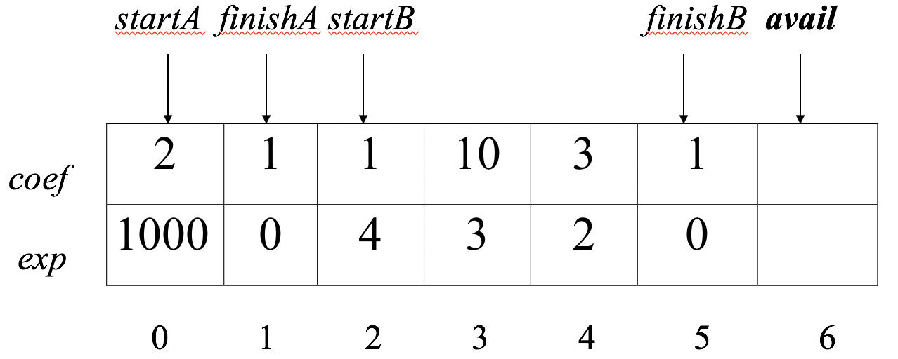
void padd (int startA, int finishA, int startB, int finishB, int *startD, int *finishD) { /* add A(x) and B(x) to obtain D(x) */ float coefficient; *startD = avail; while (startA <= finishA && startB <= finishB) switch (COMPARE(terms[startA].expon, terms[startB].expon)) { case -1: /* A expon < B expon */ attach(terms[startB].coef, terms[startB].expon); startB++ break;
Add two polynomials: D = A + B
Find the next exponent with a non-zero coefficient: Lead_Exp(a) Increase index_counter by 1 to find the next exponent

Slide 26
case 0: /* equal exponents */ coefficient = terms[startA].coef + terms[startB].coef; if (coefficient) attach (coefficient, terms[startA].expon); startA++; startB++; break; case 1: /* A expon > B expon */ attach(terms[startA].coef, terms[startA].expon); startA++; }

Slide 27
/* add in remaining terms of A(x) */ for( ; startA <= finishA; startA++) attach(terms[starta].coef, terms[starta].expon); /* add in remaining terms of B(x) */ for( ; startB <= finishB; startB++) attach(terms[startB].coef, terms[startB].expon); *finishD =avail -1; }
Analysis: O(n+m)
where n (m) is the number of nonzeros in A(B).
*Program 2.6: Function to add two polynomial (p.70)

Slide 28
void attach(float coefficient, int exponent) { /* add a new term to the polynomial */ if (avail >= MAX_TERMS) { fprintf(stderr, “Too many terms in the polynomial\n”); exit(1); } terms[avail].coef = coefficient; terms[avail++].expon = exponent; }
*Program 2.7:Function to add a new term (p.71)
Problem: Compaction is required
when polynomials are no longer needed.
(data movement takes time.)
Notes:
不夠用的時候，可以產生錯誤訊息
或者重新產生更大的儲存空間，並複製過去
有些數值沒有要再使用，則必須刪除，搬動資料很浪費時間

Slide 30
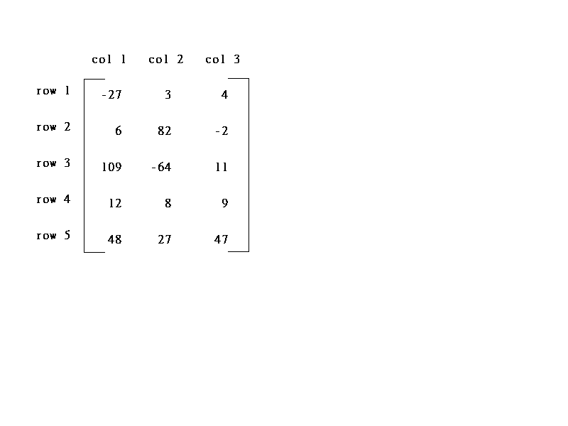
Sparse Matrix
col0 col1 col2
col0 col1 col2 col3 col4 col5
row0
row1
row2
row3
row4
row5
row0
row1
row2
row3
row4
5*3
6*6
(a) (b)
*Figure 2.4: Two matrices (p. 73)
15/15
8/36
sparse matrix
data structure?

Slide 31
Example for Sparse Matrix

Slide 32
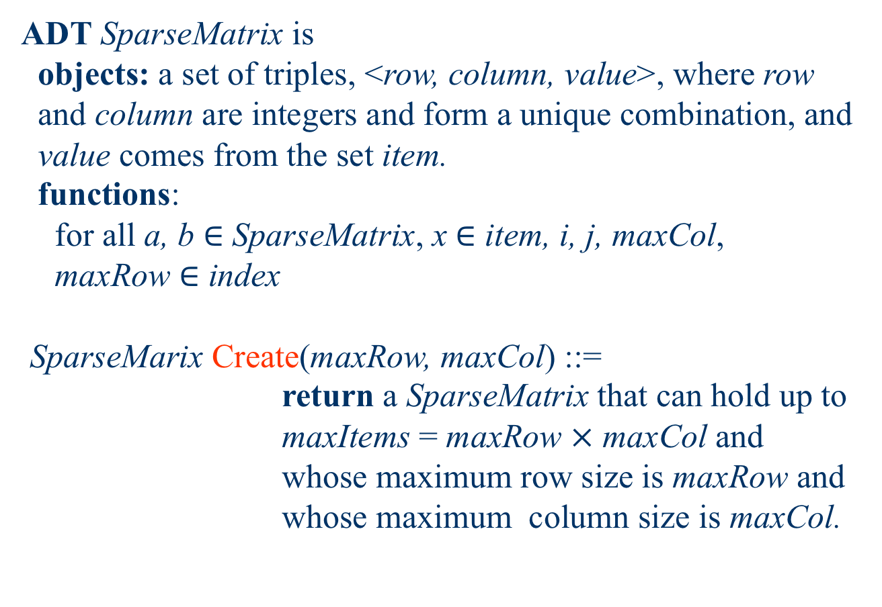
ADT SparseMatrix is objects: a set of triples, <row, column, value>, where row and column are integers and form a unique combination, and value comes from the set item. functions: for all a, b $∈$ SparseMatrix, x $∈$ item, i, j, maxCol, maxRow $∈$ index SparseMarix Create(maxRow, maxCol) ::= return a SparseMatrix that can hold up to maxItems = maxRow $×$ maxCol and whose maximum row size is maxRow and whose maximum column size is maxCol.
Sparse Matrix Abstract Data Type

Slide 33
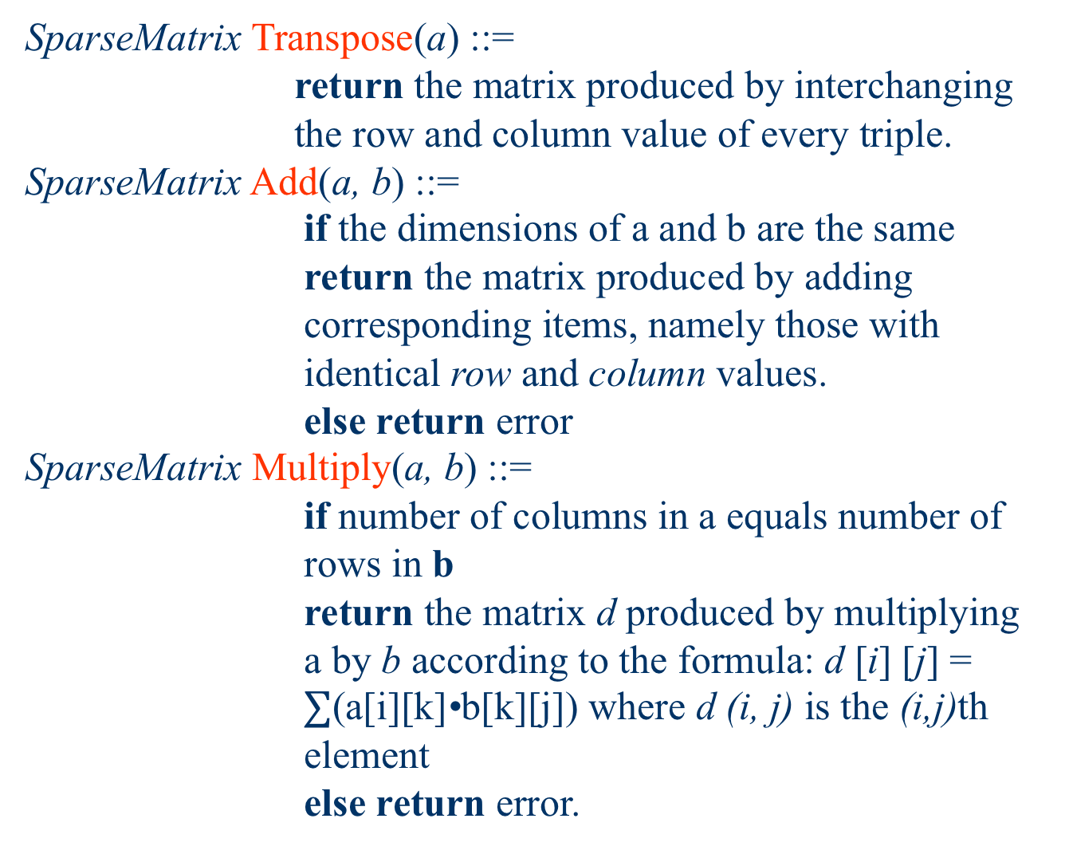
SparseMatrix Transpose(a) ::= return the matrix produced by interchanging the row and column value of every triple. SparseMatrix Add(a, b) ::= if the dimensions of a and b are the same return the matrix produced by adding corresponding items, namely those with identical row and column values. else return error SparseMatrix Multiply(a, b) ::= if number of columns in a equals number of rows in b return the matrix d produced by multiplying a by b according to the formula: d [i] [j] = $∑$(a[i][k]•b[k][j]) where d (i, j) is the (i,j)th element else return error.
* ADT 2.3: Abstract data type SparseMatrix (p. 74)

Slide 34
(1) Represented by a two-dimensional array.
Sparse matrix wastes space.

Slide 35
SparseMatrix Create(max_row, max_col) ::= #define MAX_TERMS 101 /* maximum number of terms +1*/ typedef struct { int col; int row; int value; } term; term a[MAX_TERMS]
(1) Represented by a two-dimensional array.
Sparse matrix wastes space.
(2) Represented by a one-dimensional array. Each element is characterized by <row, col, value>.
# of rows (columns)
# of nonzero terms
* (P.75)

Slide 36
Represented by a one-dimensional array
row col value a[0] 6 6 8 [1] 0 0 15 [2] 0 3 22 [3] 0 5 -15 [4] 1 1 11 [5] 1 2 3 [6] 2 3 -6 [7] 4 0 91 [8] 5 2 28
# of rows (columns)
# of nonzero terms
row, column in ascending order
*Figure 2.5: Sparse matrix and its transpose stored as triples (p.75)

Slide 37
Transpose a Matrix
(1) for each row i take element <i, j, value> and store it in element <j, i, value> of the transpose.
difficulty: where to put <j, i, value>
(0, 0, 15) ====> (0, 0, 15)
(0, 3, 22) ====> (3, 0, 22)
(0, 5, -15) ====> (5, 0, -15)
(1, 1, 11) ====> (1, 1, 11)
Hard to find the next element in the same row after transpose
(2) Sort the array according to the row index and column
➔ O (elements * log elements)

Slide 38
Transpose a Matrix
(1) for each row i take element <i, j, value> and store it in element <j, i, value> of the transpose.
difficulty: where to put <j, i, value>
(0, 0, 15) ====> (0, 0, 15)
(0, 3, 22) ====> (3, 0, 22)
(0, 5, -15) ====> (5, 0, -15)
(1, 1, 11) ====> (1, 1, 11)
Hard to find the next element in the same row after transpose
(2) Sort the array according to the row index and column
➔ O (elements * log elements) 殺雞用牛刀？
➔ Is it possible to be faster?

Slide 39
Transpose a Matrix
(1) for each row i take element <i, j, value> and store it in element <j, i, value> of the transpose.
difficulty: where to put <j, i, value>
(0, 0, 15) ====> (0, 0, 15)
(0, 3, 22) ====> (3, 0, 22)
(0, 5, -15) ====> (5, 0, -15)
(1, 1, 11) ====> (1, 1, 11)
Hard to find the next element in the same row after transpose
(3) Third solution:
For all elements in column j,
place element <i, j, value> in element <j, i, value>

Slide 40
Transpose a Matrix
row col value row col value a[0] 6 6 8 b[0] 6 6 8 [1] 0 0 15 [1] 0 0 15 [2] 0 3 22 [2] 0 4 91 [3] 0 5 -15 [3] 1 1 11 [4] 1 1 11 [4] 2 1 3 [5] 1 2 3 [5] 2 5 28 [6] 2 3 -6 [6] 3 0 22 [7] 4 0 91 [7] 3 2 -6 [8] 5 2 28 [8] 5 0 -15
# of rows (columns)
# of nonzero terms
transpose
(a) (b)
row, column in ascending order
*Figure 2.5: Sparse matrix and its transpose stored as triples (p.75)

Slide 41
void transpose (term a[], term b[]) /* b is set to the transpose of a */ { int n, i, j, currentb; n = a[0].value; /* total number of elements */ b[0].row = a[0].col; /* rows in b = columns in a */ b[0].col = a[0].row; /*columns in b = rows in a */ b[0].value = n; if (n > 0) { /*non zero matrix */ currentb = 1; for (i = 0; i < a[0].col; i++) /* transpose by columns in a */ for( j = 1; j <= n; j++) /* find elements from the current column */ if (a[j].col == i) { /* element is in current column, add it to b */
// Examine all elements to obtain the i-th Row

Slide 42
b[currentb].row = a[j].col; b[currentb].col = a[j].row; b[currentb].value = a[j].value; currentb++ } } }
columns
elements
* Program 2.8: Transpose of a sparse matrix (p.77)
Scan the array “columns” times.
The array has “elements” elements.
==> O(columns*elements)

Slide 43
Discussion: compared with 2-D array representation
O(columns*elements) vs. O(columns*rows)
elements --> columns * rows when non-sparse
➔ O(columns*columns*rows)
Problem:
Scan the array “columns” times.
We do not know the number of non-zero elements for each column.
Fourth solution:
Find the number of elements in each column of
the original matrix.
➔Find the starting positions of each row in the
transpose matrix.

Slide 44
Col [0] [1] [2] [3] [4] [5] rowTerms = 1 0 0 0 0 0 startingPos =
a[0] 6 6 8
a[1] 0 0 15
a[2] 0 3 22
a[3] 0 5 -15
a[4] 1 1 11
a[5] 1 2 3
a[6] 2 3 -6
a[7] 4 0 91
a[8] 5 2 28

Slide 45
Col [0] [1] [2] [3] [4] [5] rowTerms = 1 0 0 1 0 0 startingPos =
a[0] 6 6 8
a[1] 0 0 15
a[2] 0 3 22
a[3] 0 5 -15
a[4] 1 1 11
a[5] 1 2 3
a[6] 2 3 -6
a[7] 4 0 91
a[8] 5 2 28

Slide 46
Col [0] [1] [2] [3] [4] [5] rowTerms = 1 0 0 1 0 1 startingPos =
a[0] 6 6 8
a[1] 0 0 15
a[2] 0 3 22
a[3] 0 5 -15
a[4] 1 1 11
a[5] 1 2 3
a[6] 2 3 -6
a[7] 4 0 91
a[8] 5 2 28

Slide 47
Col [0] [1] [2] [3] [4] [5] rowTerms = 1 1 0 1 0 1 startingPos =
a[0] 6 6 8
a[1] 0 0 15
a[2] 0 3 22
a[3] 0 5 -15
a[4] 1 1 11
a[5] 1 2 3
a[6] 2 3 -6
a[7] 4 0 91
a[8] 5 2 28

Slide 48
Col [0] [1] [2] [3] [4] [5] rowTerms = 1 1 1 1 0 1 startingPos =
a[0] 6 6 8
a[1] 0 0 15
a[2] 0 3 22
a[3] 0 5 -15
a[4] 1 1 11
a[5] 1 2 3
a[6] 2 3 -6
a[7] 4 0 91
a[8] 5 2 28

Slide 49
Col [0] [1] [2] [3] [4] [5] rowTerms = 1 1 1 2 0 1 startingPos =
a[0] 6 6 8
a[1] 0 0 15
a[2] 0 3 22
a[3] 0 5 -15
a[4] 1 1 11
a[5] 1 2 3
a[6] 2 3 -6
a[7] 4 0 91
a[8] 5 2 28

Slide 50
Col [0] [1] [2] [3] [4] [5] rowTerms = 2 1 1 2 0 1 startingPos =
a[0] 6 6 8
a[1] 0 0 15
a[2] 0 3 22
a[3] 0 5 -15
a[4] 1 1 11
a[5] 1 2 3
a[6] 2 3 -6
a[7] 4 0 91
a[8] 5 2 28

Slide 51
Col [0] [1] [2] [3] [4] [5] rowTerms = 2 1 2 2 0 1 startingPos =
a[0] 6 6 8
a[1] 0 0 15
a[2] 0 3 22
a[3] 0 5 -15
a[4] 1 1 11
a[5] 1 2 3
a[6] 2 3 -6
a[7] 4 0 91
a[8] 5 2 28

Slide 52
Col [0] [1] [2] [3] [4] [5] rowTerms = 2 1 2 2 0 1 startingPos = 1 3 4 6 8 8
a[0] 6 6 8
a[1] 0 0 15
a[2] 0 3 22
a[3] 0 5 -15
a[4] 1 1 11
a[5] 1 2 3
a[6] 2 3 -6
a[7] 4 0 91
a[8] 5 2 28

Slide 53
void fast_transpose(term a[ ], term b[ ]) { /* the transpose of a is placed in b */ int rowTerms[MAX_COL], startingPos[MAX_COL]; int i, j, numCols = a[0].col, numTerms = a[0].value; b[0].row = numCols; b[0].col = a[0].row; b[0].value = numTerms; if (num_terms > 0){ /*nonzero matrix*/ for (i = 0; i < numCols; i++) rowTerms[i] = 0; for (i = 1; i <= numTerms; i++) rowTerm [a[i].col]++ startingPos[0] = 1; for (i =1; i < numCols; i++) startingPos[i]=startingPos[i-1] +rowTerms [i-1];
columns
// Initialize rowTerms
elements
// Count rowTerms
// Generate startingPos
columns

Slide 54
for (i=1; i <= num_terms, i++) { j = startingPos[a[i].col]++; b[j].row = a[i].col; b[j].col = a[i].row; b[j].value = a[i].value; } } } *Program 2.9: Fast transpose of a sparse matrix (p. 78)
elements
Fast transpose vs 2-D array representation
O(columns+elements) vs. O(columns*rows)
When elements --> columns * rows
O(columns+elements) --> O(columns*rows)
Cost: Additional rowTerms and startingPos arrays are required.
Let the two arrays rowTerms and startingPos be shared.

Slide 55
for (i=1; i <= num_terms, i++) { j = startingPos[a[i].col]++; b[j].row = a[i].col; b[j].col = a[i].row; b[j].value = a[i].value; } } } *Program 2.9: Fast transpose of a sparse matrix (p. 78)
elements
Fast transpose vs 2-D array representation
O(columns+elements) vs. O(columns*rows)
When elements --> columns * rows
O(columns+elements) --> O(columns*rows)
Cost: Additional rowTerms and startingPos arrays are required.
Let the two arrays rowTerms and startingPos be shared.
Which one is better?
Fast transpose vs Swap + Sorting
Swap: O (elements)
Sorting: O (elements * log elements)

Slide 56
Sparse Matrix Multiplication
Definition: [D]_{m*p}=[A]_{m*n}* [B]_{n*p}
Procedure: Fix a row of A and find all elements in column j
of B for j=0, 1, …, p-1.
*Figure 2.6: Multiplication of two sparse matrices (p.80)

Slide 57
Sparse Matrix Multiplication
Definition: [D]_{m*p}=[A]_{m*n}* [B]_{n*p}
Procedure: Fix a row of A and find all elements in column j
of B for j=0, 1, …, p-1.
Alternative 1. Scan all of B to find all elements in column j.
*Figure 2.6: Multiplication of two sparse matrices (p.80)

Slide 58
Sparse Matrix Multiplication
Definition: [D]_{m*p}=[A]_{m*n}* [B]_{n*p}
Procedure: Fix a row of A and find all elements in column j
of B for j=0, 1, …, p-1.
Alternative 1. Scan all of B to find all elements in column j.
Alternative 2. Compute the transpose of B.
(Put all column elements consecutively)
*Figure 2.6: Multiplication of two sparse matrices (p.80)

Slide 59
A = 1 0 2 B = 3 0 2
-1 4 6 -1 0 0
0 0 0 0 0 5
3 3 5 3 3 4
0 0 1 0 0 3
0 2 2 0 2 2
1 0 -1 1 0 -1
1 1 4 2 2 5
1 2 6
B^{T} = 3 -1 0 3 3 4
0 0 0 0 0 3
2 0 5 0 1 -1
2 0 2
2 2 5
An Example
(0,0)
(0,2)
(1,0)
(1,2)
Notes:
Row 0 of A * Row 0 of B^T
Row 0 of A * Row 1 of B^T → 空
Row 0 of A * Row 2 of B^T
Row 1 of A * Row 0 of B^T
Row 1 of A * Row 1 of B^T → 空
Row 1 of A * Row 2 of B^T

Slide 60
General Case
d_{ij}=a_{i0}*b_{0j}+a_{i1}*b_{1j}+…+a_{i(n-1)*}b_{(n-1)j}
a本來依i成群，經轉置後，b也依j成群。
a Sa d Sd
b Sb e Se
c Sc f Sf
g Sg
最多可以產生ad, ae, af, ag,
bd, be, bf, bg,
cd, ce, cf, cg 等entries 。

Slide 61
void mmult (term a[ ], term b[ ], term d[ ] ) /* multiply two sparse matrices */ { int i, j, column, totalB = b[0].value, totalD = 0; int rowsA = a[0].row, colsA = a[0].col, totalA = a[0].value; int colsB = b[0].col, int rowBegin = 1, row = a[1].row, sum =0; term newB[MAX_TERMS]; if (colsA != b[0].row){ fprintf (stderr, “Incompatible matrices\n”); exit (1); } fast_transpose(b, newB); /* set boundary condition */ a[totalA+1].row = rowsA; newB[totalB+1].row = colsB; newB[totalB+1].col = 0;
// colsB + totalB
Notes:
totalA, totalB, A和B的非0元數個數
row 用來計算現在的位置

Slide 62
for (i = 1; i <= totalA; ) { column = newB[1].row; for (j = 1; j <= totalB+1;) { /* mutiply row of a by column of b */ if (a[i].row != row) { storesum(d, &totalD, row, column, &sum); i = rowBegin; for (; newB[j].row == column; j++) ; column =newB[j].row } else if (newB[j].row != column) { storesum(d, &totalD, row, column, &sum); i = rowBegin; column =newB[j].row }
// Count the rows of A
// If the row of A is changed
// Update result d
// Discard the remaining cols of B
// If the row of B is changed
// Update result d
// Discard the remaining cols of A

Slide 63
else switch (COMPARE (a[i].col, newB[j].col)) { case -1: /* go to next term in a */ i++; break; case 0: /* add terms, go to next term in a and b */ sum += (a[i++].value * newB[j++].value); break; case 1: /* advance to next term in b*/ j++ } } /* end of for j <= totalB+1 */ for (; a[i].row == row; i++) ; rowBegin = i; row = a[i].row; } /* end of for i <=totalA */ d[0].row = rowsA; d[0].col = colsB; d[0].value = totalD; }
// Change row of A
*Praogram 2.10: Sparse matrix multiplication (p.82)

Slide 64
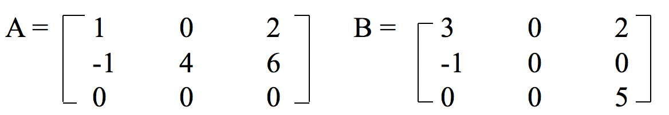
Analyzing the algorithm
colsB * termsrow₁ + totalB +…
# non-zero elements in row 1 of A

Slide 65
Analyzing the algorithm
colsB * termsrow₁ + totalB +
colsB * termsrow₂ + totalB +
… +
colsB * termsrow_{m} + totalB
= colsB * (termsrow₁ + termsrow₂ + … + termsrow_{m}) +
rowsA * totalB
= colsB * totalA + rowA * totalB
O(colsB * totalA + rowsA * totalB)

Slide 66
for (i =0; i < rowsA; i++) for (j=0; j < colsB; j++) { sum =0; for (k=0; k < colsA; k++) sum += (a[i][k] *b[k][j]); d[i][j] =sum; }
Compared with matrix multiplication using array
It is also rowsB
O(rowsA * colsA * colsB) vs.
O(colsB * totalA + rowsA * totalB)
optimal case: totalA << rowsA * colsA
totalB << colsA * colsB
worst case: totalA --> rowsA * colsA, or
totalB --> colsA * colsB

Slide 67
void storesum(term d[ ], int *totalD, int row, int column, int *sum) { /* if *sum != 0, then it along with its row and column position is stored as the *totalD+1 entry in d */ if (*sum) if (*totalD < MAX_TERMS) { d[++*totalD].row = row; d[*totalD].col = column; d[*totalD].value = *sum; } else { fprintf(stderr, ”Numbers of terms in product exceed %d\n”, MAX_TERMS); exit(1); } }
Program 2.11: storsum function (p. 82)

Slide 69
Abstract Data Type of Strings
A string has the form, S = s₀, s₁, …, s_{n-1}, where s_{i} are characters taken from the character set of the programming language
If n = 0, then S is an empty or null string
Operations:
Creating a string, reading a string, printing a string out, appending two strings(or concatenation), copying a string
Comparing two strings, inseting a substring into a string, removing a substring from a string, finding a pattern in a string
…

Slide 70
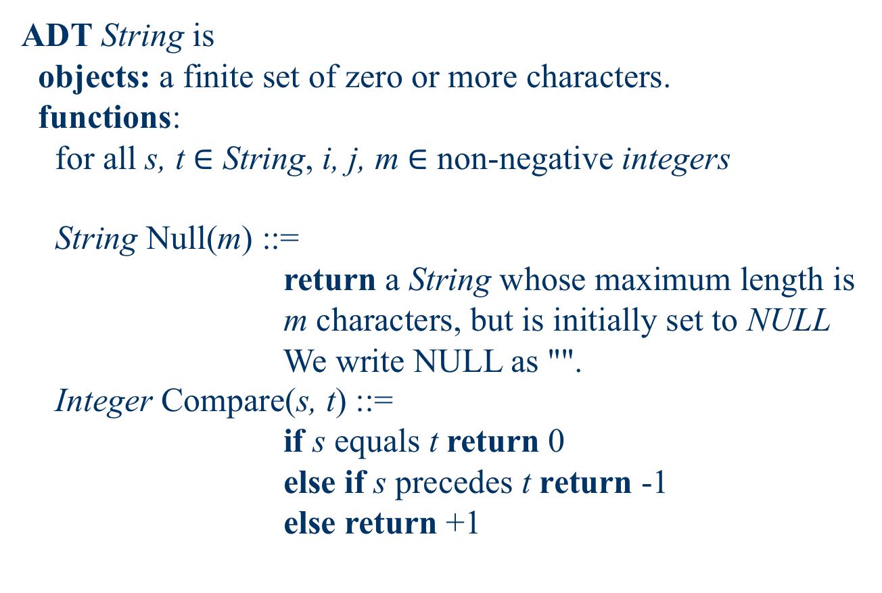
ADT String is objects: a finite set of zero or more characters. functions: for all s, t $∈$ String, i, j, m $∈$ non-negative integers String Null(m) ::= return a String whose maximum length is m characters, but is initially set to NULL We write NULL as "". Integer Compare(s, t) ::= if s equals t return 0 else if s precedes t return -1 else return +1
ADT of String

Slide 71
Boolean IsNull(s) ::= if (Compare(s, NULL)) return FALSE else return TRUE Integer Length(s) ::= if (Compare(s, NULL)) return the number of characters in s else return 0 String Concat(s, t) ::= if (Compare(t, NULL)) return a string whose elements are those of s followed by those of t else return s String Substr(s, i, j) ::= if ((j > 0) && (i + j – 1) < Length (s)) return the string containing the characters of s at positions i, i + 1, …, i + j - 1 else return NULL

Slide 72
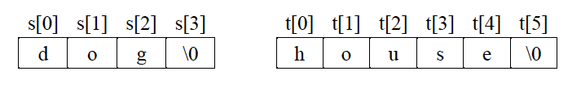
Representation of Strings
In C, we represent strings as character arrays terminated with the null character \0
#define MAX_SIZE 100 /* maximum size of string */
char s[MAX_SIZE]={“dog”}; char t[MAX_SIZE]={“house”};
Alternative declaration
C will allocates exactly just enough space to hold each word including \0
char s[]={“dog”}; char t[]={“house”};

Slide 73
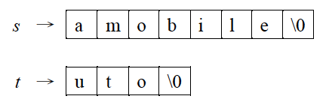
String Insertion
There are two strings, say string1 and string2, and we want to insert string2 into string1 starting at the ith position of string1
#include <string.h>
#define MAX_SIZE 100 /*size of largest string*/
char string1[MAX_SIZE], *s = string1;
char string2[MAX_SIZE], *t = string2;
Insert “uto” starting at the position i=1 of the first string
(not normally found in <string.h>)

Slide 74
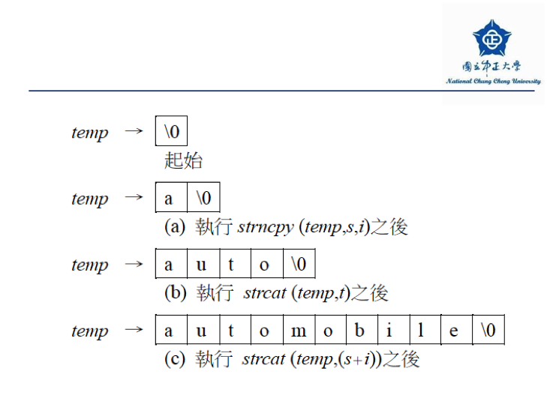
String Insertion
Initially
After strncpy(temp, s, i)
After strcat(temp, t)
After strcat(temp, (s + i))

Slide 75
String Insertion
void strnins(char *s, char *t, int i) { /*insert string t into string s at position i*/
char string[MAX_SIZE], *temp = string;
if (i < 0 && i > strlen(s)) {
fprintf(stderr,”Position is out of bounds \n”);
exit(EXIT_FAILURE);
}
if (!strlen(s))
strcpy(s,t);
else if (strlen(t)) {
strncpy(temp, s, i);
strcat(temp, t);
strcat(temp, (s+i));
strcpy(s, temp);
} }
*Praogram 2.12: String insertion function (p.92)

Slide 77
Pattern Matching
There are two strings, say string and pat, where pat is a pattern to be searched for in string
Using the built-in function strstr:
char pat[MAX_SIZE], string[MAX_SIZE], *t;
if (t = strstr(string, pat))
printf(“The string from strstr is: %s\n”, t);
else
printf(“The pattern was not found with strstr\n”);
The call (t = strstr(string, pat)) returns
A null pointer if pat is not in string
If pat is in string, t holds a pointer to the start of pat in string

Slide 78
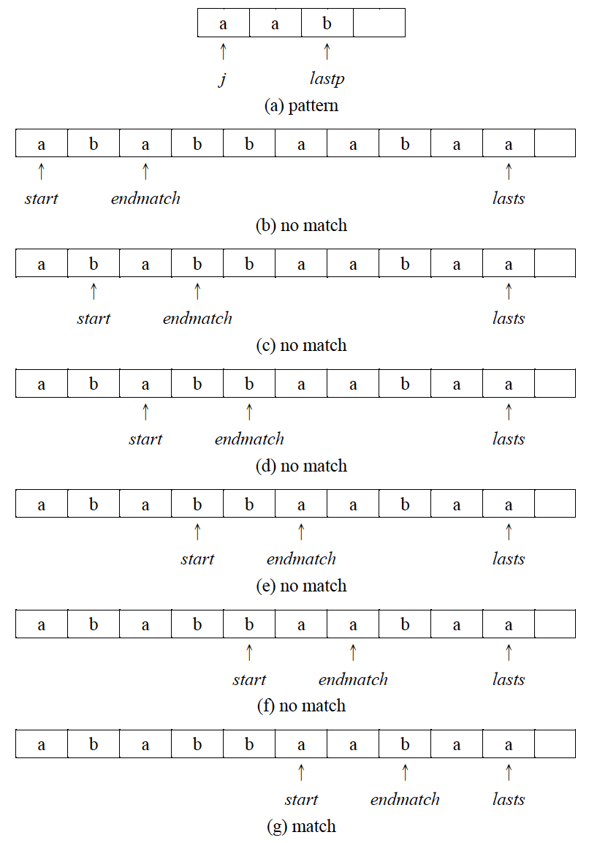
Pattern Matching
How to implement strstr(string, pat)?
First try:
Sequentially examine each character of the string until it finds the pattern or it reaches the end of the string

Slide 80
Pattern Matching
int nfind(char *string, char *pat)
{ /* match the last character of pattern first,
then match from the beginning*/
int i,j,start = 0;
int lasts = strlen(string)-1;
int lastp = strlen(pat)-1;
int endmatch = lastp;
for (i = 0; endmatch <= lasts; endmatch++, start++) {
if (string[endmatch] == pat[lastp]) {
for (j = 0, i = start; j < lastp && string[i] == pat[j]; i++,j++);
if (j == lastp) return start; /* successful*/
}
}
return -1;
}
*Praogram 2.13: Pattern matching by checking end indices first (p.93)

Slide 81
Pattern Matching
How to implement strstr(string, pat)?
First try:
Sequentially examine each character of the string until it finds the pattern or it reaches the end of the string
O(strlen(pat) * strlen(string))
How to do better than this?

Slide 82
Pattern Matching
Can we search the string for the pattern in linear time?
s=‘- a b c a b c a ? ? ? -’
pat=‘a b c a b c a d a b’

Slide 83
Pattern Matching
Can we search the string for the pattern in linear time?
s=‘- a b c a b c a ? ? ? -’
pat=‘a b c a b c a d a b’
Moving backwards increases time complexity

Slide 84
Pattern Matching
Can we search the string for the pattern in linear time?
Can we search the string for the pattern without moving backwards in the string?
s=‘- a b c a b c a ? ? ? -’
pat=‘a b c a b c a d a b’
pat=‘a b c a b c a d a b’

Slide 85
Pattern Matching
Can we search the string for the pattern in linear time?
Can we search the string for the pattern without moving backwards in the string?
s=‘- a b c a b c a ? ? ? -’
pat=‘a b c a b c a d a b’
pat=‘a b c a b c a d a b’
pat=‘a b c a b c a d a b’

Slide 86
Pattern Matching
Can we search the string for the pattern in linear time?
Can we search the string for the pattern without moving backwards in the string?
s=‘- a b c a b c a ? ? ? -’
pat=‘a b c a b c a d a b’
pat=‘a b c a b c a d a b’
pat=‘a b c a b c a d a b’
pat=‘a b c a b c a d a b’

Slide 87
Pattern Matching
Can we search the string for the pattern in linear time?
Can we search the string for the pattern without moving backwards in the string?
s=‘- a b c a b c a ? ? ? -’
pat=‘a b c a b c a d a b’
pat=‘a b c a b c a d a b’
pat=‘a b c a b c a d a b’
pat=‘a b c a b c a d a b’
It seems to compare ‘pat’ with ‘pat’

Slide 88
Pattern Matching
Can we search the string for the pattern in linear time?
Can we search the string for the pattern without moving backwards in the string?
s=‘- a b c a b c a ? ? ? -’
pat=‘a b c a b c a d a b’
pat=‘a b c a b c a d a b’
pat=‘a b c a b c a d a b’
pat=‘a b c a b c a d a b’
It seems to compare ‘pat’ with ‘pat’

Slide 89
Pattern Matching
Can we search the string for the pattern in linear time?
Can we search the string for the pattern without moving backwards in the string?
s=‘- a b c a b c a ? ? ? -’
pat=‘a b c a b c a d a b’
pat=‘a b c a b c a d a b’
pat=‘a b c a b c a d a b’
pat=‘a b c a b c a d a b’
Let’s examine the prefix and suffix of the pattern
前綴
後綴

Slide 90
Pattern Matching
Let’s examine the prefix and suffix of the pattern
s=‘- a b c a b c a ? . . ? -’
pat=‘a b c a b c a d a b’
pat=‘a b c a b c a d a b’
pat=‘a b c a b c a d a b’
pat=‘a b c a b c a d a b’

Slide 91
Pattern Matching
Let’s examine the prefix and suffix of the pattern
s=‘- a b c a b c a ? . . ? -’
pat=‘a b c a b c a d a b’
pat=‘a b c a b c a d a b’
pat=‘a b c a b c a d a b’
pat=‘a b c a b c a d a b’
j 0 1 2 3 4 5 6 7 8 9
pat a b c a b c a d a b
f -1

Slide 92
Pattern Matching
Let’s examine the prefix and suffix of the pattern
s=‘- a b c a b c a ? . . ? -’
pat=‘a b c a b c a d a b’
pat=‘a b c a b c a d a b’
pat=‘a b c a b c a d a b’
pat=‘a b c a b c a d a b’
j 0 1 2 3 4 5 6 7 8 9
pat a b c a b c a d a b
f -1 -1

Slide 93
Pattern Matching
Let’s examine the prefix and suffix of the pattern
s=‘- a b c a b c a ? . . ? -’
pat=‘a b c a b c a d a b’
pat=‘a b c a b c a d a b’
pat=‘a b c a b c a d a b’
pat=‘a b c a b c a d a b’
j 0 1 2 3 4 5 6 7 8 9
pat a b c a b c a d a b
f -1 -1 -1

Slide 94
Pattern Matching
Let’s examine the prefix and suffix of the pattern
s=‘- a b c a b c a ? . . ? -’
pat=‘a b c a b c a d a b’
pat=‘a b c a b c a d a b’
pat=‘a b c a b c a d a b’
pat=‘a b c a b c a d a b’
j 0 1 2 3 4 5 6 7 8 9
pat a b c a b c a d a b
f -1 -1 -1 0

Slide 95
Pattern Matching
Let’s examine the prefix and suffix of the pattern
s=‘- a b c a b c a ? . . ? -’
pat=‘a b c a b c a d a b’
pat=‘a b c a b c a d a b’
pat=‘a b c a b c a d a b’
pat=‘a b c a b c a d a b’
j 0 1 2 3 4 5 6 7 8 9
pat a b c a b c a d a b
f -1 -1 -1 0 1

Slide 96
Pattern Matching
Let’s examine the prefix and suffix of the pattern
s=‘- a b c a b c a ? . . ? -’
pat=‘a b c a b c a d a b’
pat=‘a b c a b c a d a b’
pat=‘a b c a b c a d a b’
pat=‘a b c a b c a d a b’
j 0 1 2 3 4 5 6 7 8 9
pat a b c a b c a d a b
f -1 -1 -1 0 1 2

Slide 97
Pattern Matching
Let’s examine the prefix and suffix of the pattern
s=‘- a b c a b c a ? . . ? -’
pat=‘a b c a b c a d a b’
pat=‘a b c a b c a d a b’
pat=‘a b c a b c a d a b’
pat=‘a b c a b c a d a b’
j 0 1 2 3 4 5 6 7 8 9
pat a b c a b c a d a b
f -1 -1 -1 0 1 2 3

Slide 98
Pattern Matching
Let’s examine the prefix and suffix of the pattern
s=‘- a b c a b c a ? . . ? -’
pat=‘a b c a b c a d a b’
pat=‘a b c a b c a d a b’
pat=‘a b c a b c a d a b’
pat=‘a b c a b c a d a b’
j 0 1 2 3 4 5 6 7 8 9
pat a b c a b c a d a b
f -1 -1 -1 0 1 2 3 -1

Slide 99
Pattern Matching
Let’s examine the prefix and suffix of the pattern
s=‘- a b c a b c a ? . . ? -’
pat=‘a b c a b c a d a b’
pat=‘a b c a b c a d a b’
pat=‘a b c a b c a d a b’
pat=‘a b c a b c a d a b’
j 0 1 2 3 4 5 6 7 8 9
pat a b c a b c a d a b
f -1 -1 -1 0 1 2 3 -1 0

Slide 100
Pattern Matching
Let’s examine the prefix and suffix of the pattern
s=‘- a b c a b c a ? . . ? -’
pat=‘a b c a b c a d a b’
pat=‘a b c a b c a d a b’
pat=‘a b c a b c a d a b’
pat=‘a b c a b c a d a b’
j 0 1 2 3 4 5 6 7 8 9
pat a b c a b c a d a b
f -1 -1 -1 0 1 2 3 -1 0 1

Slide 101
Pattern Matching
Rules for pattern match
If a partial match is found such that s_{i-j}...s_{i-1} = p₀ p₁ ... p_{j-1} and s_{i} ≠ p_{j}, then matching may be resumed by comparing s_{i} and p_{f(j-1)+1} if j ≠ 0
If j = 0, we continue by comparing s_{i+1} and p₀
s=‘- a b c a b c a ? . . ? -’
pat=‘a b c a b c a d a b’
pat=‘a b c a b c a d a b’
j 0 1 2 3 4 5 6 7 8 9
pat a b c a b c a d a b
f -1 -1 -1 0 1 2 3 -1 0 1

Slide 102
Pattern Matching
Rules for pattern match
If a partial match is found such that s_{i-j}...s_{i-1} = p₀ p₁ ... p_{j-1} and s_{i} ≠ p_{j}, then matching may be resumed by comparing s_{i} and p_{f(j-1)+1} if j ≠ 0
If j = 0, we continue by comparing s_{i+1} and p₀
s=‘- a b c a b c a ? . . ? -’
pat=‘a b c a b c a d a b’
pat=‘a b c a b c a d a b’
j 0 1 2 3 4 5 6 7 8 9
pat a b c a b c a d a b
f -1 -1 -1 0 1 2 3 -1 0 1

Slide 103
Pattern Matching
Rules for pattern match
If a partial match is found such that s_{i-j}...s_{i-1} = p₀ p₁ ... p_{j-1} and s_{i} ≠ p_{j}, then matching may be resumed by comparing s_{i} and p_{f(j-1)+1} if j ≠ 0
If j = 0, we continue by comparing s_{i+1} and p₀
s=‘- a b c a b c a ? . . ? -’
pat=‘a b c a b c a d a b’
pat=‘a b c a b c a d a b’
j 0 1 2 3 4 5 6 7 8 9
pat a b c a b c a d a b
f -1 -1 -1 0 1 2 3 -1 0 1

Slide 104
Pattern Matching
Rules for pattern match
If a partial match is found such that s_{i-j}...s_{i-1} = p₀ p₁ ... p_{j-1} and s_{i} ≠ p_{j}, then matching may be resumed by comparing s_{i} and p_{f(j-1)+1} if j ≠ 0
If j = 0, we continue by comparing s_{i+1} and p₀
s=‘- a b c a b c a ? . . ? -’
pat=‘a b c a b c a d a b’
pat=‘a b c a b c a d a b’
j 0 1 2 3 4 5 6 7 8 9
pat a b c a b c a d a b
f -1 -1 -1 0 1 2 3 -1 0 1

Slide 105
Pattern Matching
Rules for pattern match
If a partial match is found such that s_{i-j}...s_{i-1} = p₀ p₁ ... p_{j-1} and s_{i} ≠ p_{j}, then matching may be resumed by comparing s_{i} and p_{f(j-1)+1} if j ≠ 0
If j = 0, we continue by comparing s_{i+1} and p₀
s=‘- a b c a b c a ? . . ? -’
pat=‘a b c a b c a d a b’
pat=‘a b c a b c a d a b’
j 0 1 2 3 4 5 6 7 8 9
pat a b c a b c a d a b
f -1 -1 -1 0 1 2 3 -1 0 1

Slide 106
Pattern Matching
Rules for pattern match
If a partial match is found such that s_{i-j}...s_{i-1} = p₀ p₁ ... p_{j-1} and s_{i} ≠ p_{j}, then matching may be resumed by comparing s_{i} and p_{f(j-1)+1} if j ≠ 0
If j = 0, we continue by comparing s_{i+1} and p₀
s=‘- a b c a b c a ? . . ? -’
pat=‘a b c a b c a d a b’
pat=‘a b c a b c a d a b’
j 0 1 2 3 4 5 6 7 8 9
pat a b c a b c a d a b
f -1 -1 -1 0 1 2 3 -1 0 1

Slide 107
Pattern Matching
int pmatch(char *string, char *pat) { /* Knuth, Morris, Pratt string match
algorithm*/
int i = 0, j = 0; int lens = strlen(string); int lenp = strlen(pat); while ( i < lens && j < lenp ) {
if (string[i] == pat[j]) {
i++; j++;
} else if (j == 0) i++;
else j = failure[j-1]+1;
}
return ( (j == lenp) ? (i-lenp) : -1);
}
*Praogram 2.14: Knuth, Morris, Pratt pattern matching algorithm (p.96)

Slide 108
Pattern Matching
int pmatch(char *string, char *pat) { /* Knuth, Morris, Pratt string match
algorithm*/
int i = 0, j = 0; int lens = strlen(string); int lenp = strlen(pat); while ( i < lens && j < lenp ) {
if (string[i] == pat[j]) {
i++; j++;
} else if (j == 0) i++;
else j = failure[j-1]+1;
}
return ( (j == lenp) ? (i-lenp) : -1);
}
How many times i can be increased?
How many times j can be increased?
*Praogram 2.14: Knuth, Morris, Pratt pattern matching algorithm (p.96)

Slide 109
Pattern Matching
int pmatch(char *string, char *pat) { /* Knuth, Morris, Pratt string match
algorithm*/
int i = 0, j = 0; int lens = strlen(string); int lenp = strlen(pat); while ( i < lens && j < lenp ) {
if (string[i] == pat[j]) {
i++; j++;
} else if (j == 0) i++;
else j = failure[j-1]+1;
}
return ( (j == lenp) ? (i-lenp) : -1);
}
How many times i can be increased?
O(strlen(string))
How many times j can be increased? O(strlen(string))
*Praogram 2.14: Knuth, Morris, Pratt pattern matching algorithm (p.96)

Slide 110
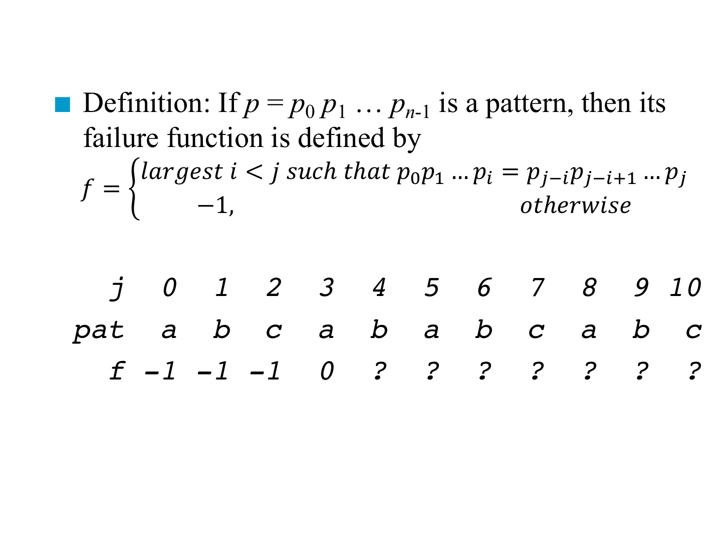
Prefix and Suffix
Definition: If p = p₀ p₁ … p_{n-1} is a pattern, then its failure function is defined by
$$f=\left\{\begin{aligned}largest i<j such that p_{0}p_{1}…p_{i}=p_{j−i}p_{j−i+1}…p_{j} \\ −1, otherwise\end{aligned}\right.$$
j 0 1 2 3 4 5 6 7 8 9 10
pat a b c a b a b c a b c
f -1 -1 -1 0 ? ? ? ? ? ? ?
前綴
後綴

Slide 111
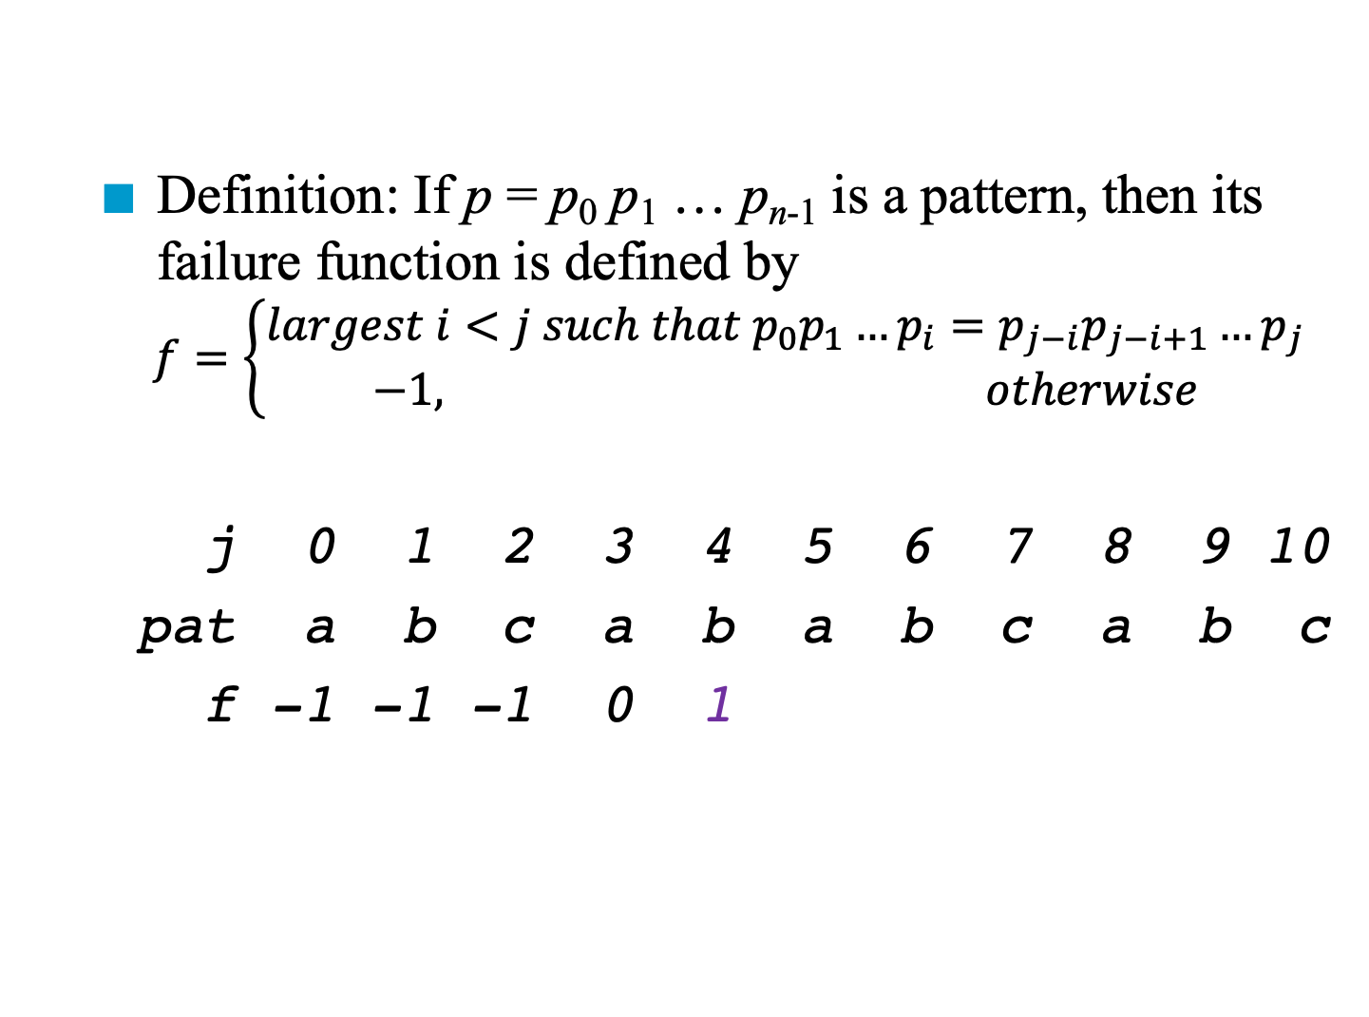
Prefix and Suffix
Definition: If p = p₀ p₁ … p_{n-1} is a pattern, then its failure function is defined by
$$f=\left\{\begin{aligned}largest i<j such that p_{0}p_{1}…p_{i}=p_{j−i}p_{j−i+1}…p_{j} \\ −1, otherwise\end{aligned}\right.$$
j 0 1 2 3 4 5 6 7 8 9 10
pat a b c a b a b c a b c
f -1 -1 -1 0 1
前綴
後綴

Slide 112
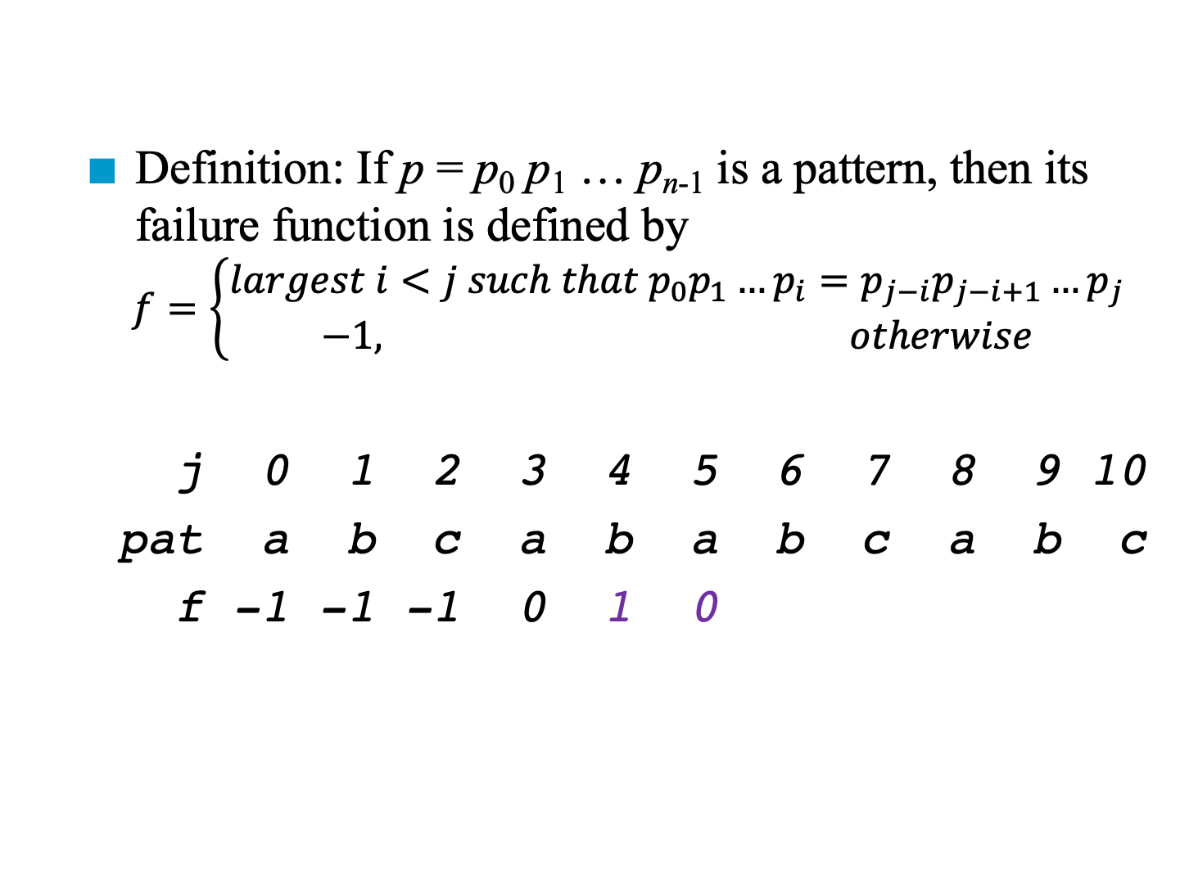
Prefix and Suffix
Definition: If p = p₀ p₁ … p_{n-1} is a pattern, then its failure function is defined by
$$f=\left\{\begin{aligned}largest i<j such that p_{0}p_{1}…p_{i}=p_{j−i}p_{j−i+1}…p_{j} \\ −1, otherwise\end{aligned}\right.$$
j 0 1 2 3 4 5 6 7 8 9 10
pat a b c a b a b c a b c
f -1 -1 -1 0 1 0
前綴
後綴

Slide 113
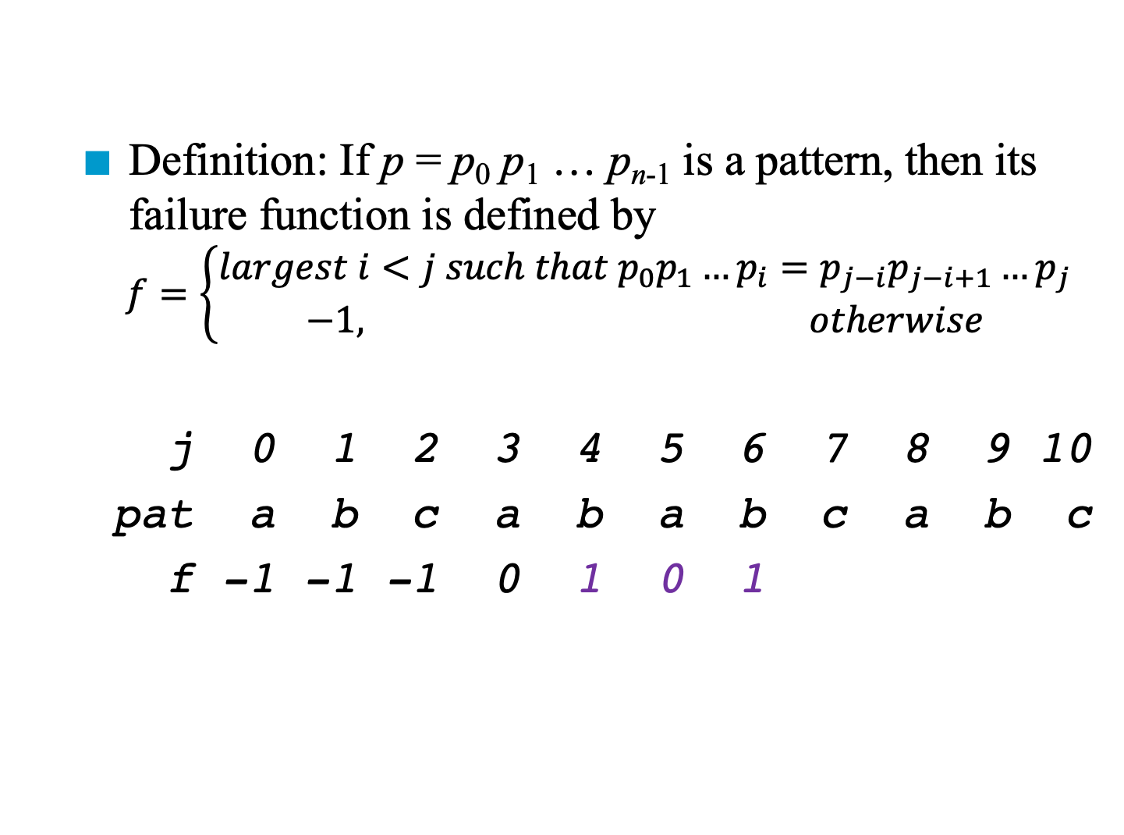
Prefix and Suffix
Definition: If p = p₀ p₁ … p_{n-1} is a pattern, then its failure function is defined by
$$f=\left\{\begin{aligned}largest i<j such that p_{0}p_{1}…p_{i}=p_{j−i}p_{j−i+1}…p_{j} \\ −1, otherwise\end{aligned}\right.$$
j 0 1 2 3 4 5 6 7 8 9 10
pat a b c a b a b c a b c
f -1 -1 -1 0 1 0 1
前綴
後綴

Slide 114
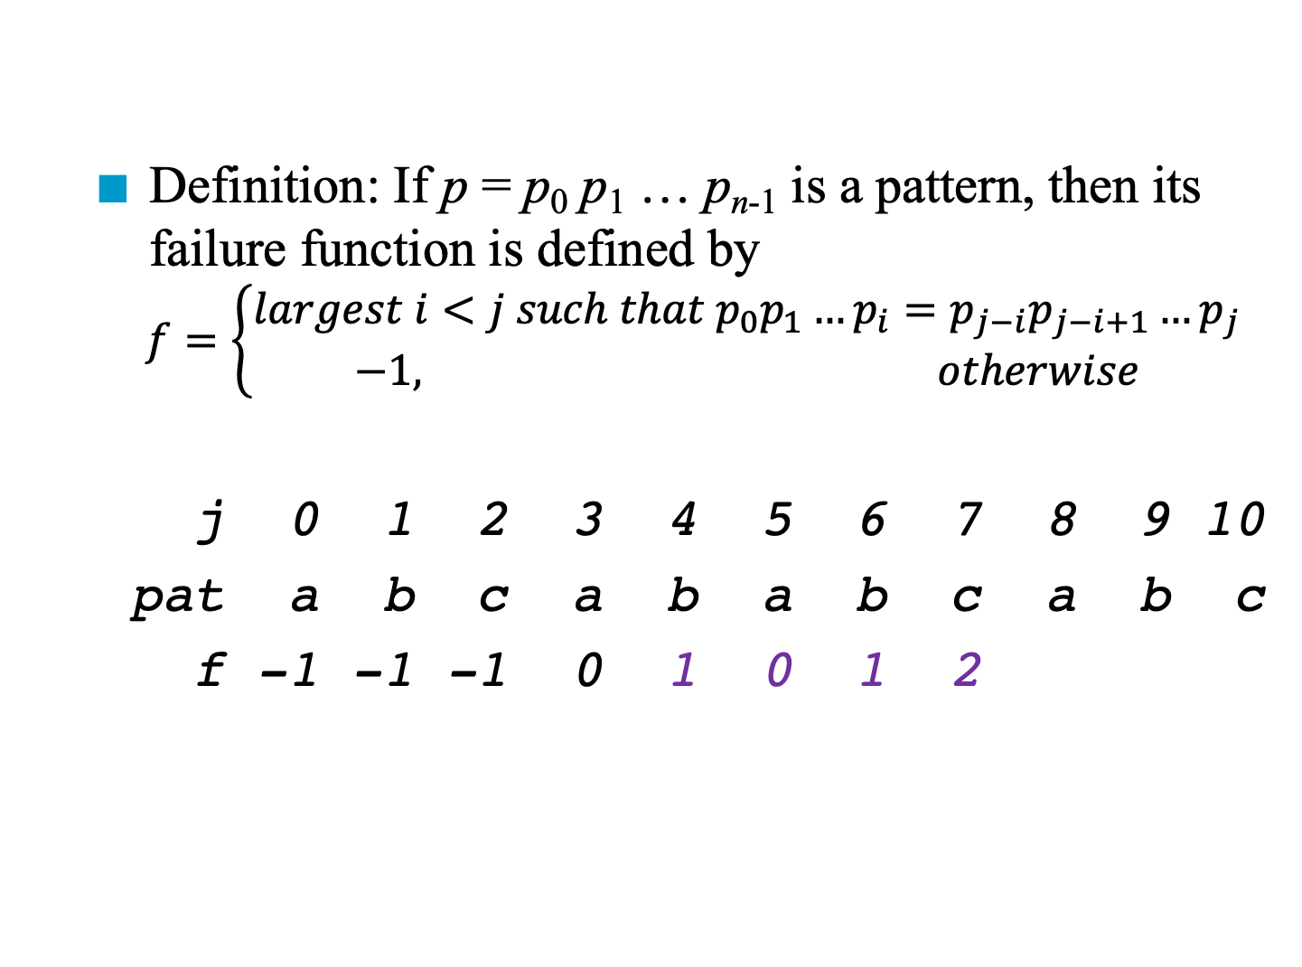
Prefix and Suffix
Definition: If p = p₀ p₁ … p_{n-1} is a pattern, then its failure function is defined by
$$f=\left\{\begin{aligned}largest i<j such that p_{0}p_{1}…p_{i}=p_{j−i}p_{j−i+1}…p_{j} \\ −1, otherwise\end{aligned}\right.$$
j 0 1 2 3 4 5 6 7 8 9 10
pat a b c a b a b c a b c
f -1 -1 -1 0 1 0 1 2
前綴
後綴

Slide 115
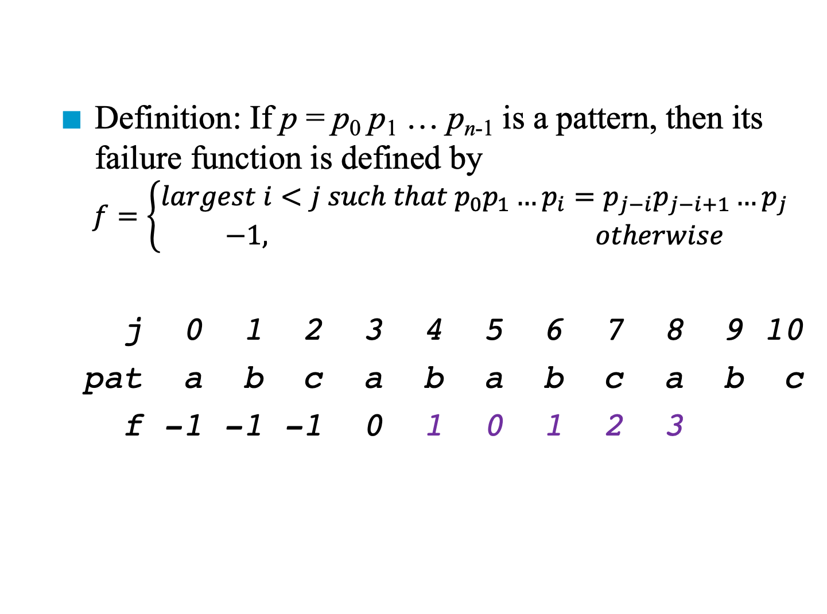
Prefix and Suffix
Definition: If p = p₀ p₁ … p_{n-1} is a pattern, then its failure function is defined by
$$f=\left\{\begin{aligned}largest i<j such that p_{0}p_{1}…p_{i}=p_{j−i}p_{j−i+1}…p_{j} \\ −1, otherwise\end{aligned}\right.$$
j 0 1 2 3 4 5 6 7 8 9 10
pat a b c a b a b c a b c
f -1 -1 -1 0 1 0 1 2 3
前綴
後綴

Slide 116
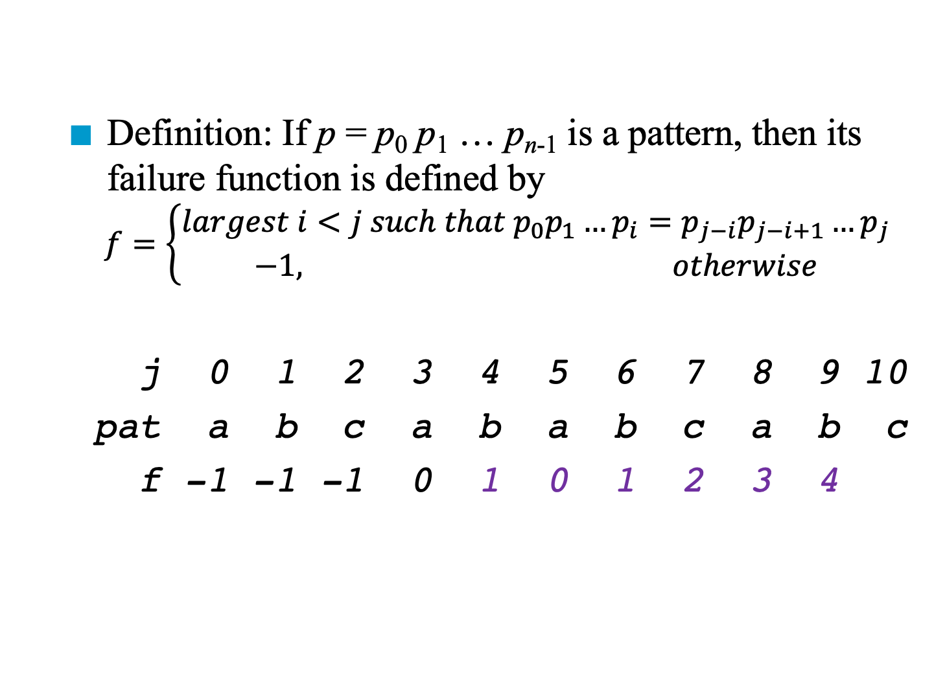
Prefix and Suffix
Definition: If p = p₀ p₁ … p_{n-1} is a pattern, then its failure function is defined by
$$f=\left\{\begin{aligned}largest i<j such that p_{0}p_{1}…p_{i}=p_{j−i}p_{j−i+1}…p_{j} \\ −1, otherwise\end{aligned}\right.$$
j 0 1 2 3 4 5 6 7 8 9 10
pat a b c a b a b c a b c
f -1 -1 -1 0 1 0 1 2 3 4
前綴
後綴

Slide 117
Prefix and Suffix
Definition: If p = p₀ p₁ … p_{n-1} is a pattern, then its failure function is defined by
$$f=\left\{\begin{aligned}largest i<j such that p_{0}p_{1}…p_{i}=p_{j−i}p_{j−i+1}…p_{j} \\ −1, otherwise\end{aligned}\right.$$
j 0 1 2 3 4 5 6 7 8 9 10
pat a b c a b a b c a b c
f -1 -1 -1 0 1 0 1 2 3 4
前綴
後綴

Slide 118
Prefix and Suffix
Definition: If p = p₀ p₁ … p_{n-1} is a pattern, then its failure function is defined by
$$f=\left\{\begin{aligned}largest i<j such that p_{0}p_{1}…p_{i}=p_{j−i}p_{j−i+1}…p_{j} \\ −1, otherwise\end{aligned}\right.$$
j 0 1 2 3 4 5 6 7 8 9 10
pat a b c a b a b c a b c
f -1 -1 -1 0 1 0 1 2 3 4
前綴
後綴

Slide 119
Prefix and Suffix
Definition: If p = p₀ p₁ … p_{n-1} is a pattern, then its failure function is defined by
$$f=\left\{\begin{aligned}largest i<j such that p_{0}p_{1}…p_{i}=p_{j−i}p_{j−i+1}…p_{j} \\ −1, otherwise\end{aligned}\right.$$
j 0 1 2 3 4 5 6 7 8 9 10
pat a b c a b a b c a b c
f -1 -1 -1 0 1 0 1 2 3 4
前綴
後綴

Slide 120
Prefix and Suffix
Definition: If p = p₀ p₁ … p_{n-1} is a pattern, then its failure function is defined by
$$f=\left\{\begin{aligned}largest i<j such that p_{0}p_{1}…p_{i}=p_{j−i}p_{j−i+1}…p_{j} \\ −1, otherwise\end{aligned}\right.$$
j 0 1 2 3 4 5 6 7 8 9 10
pat a b c a b a b c a b c
f -1 -1 -1 0 1 0 1 2 3 4
前綴
後綴

Slide 121
Prefix and Suffix
Definition: If p = p₀ p₁ … p_{n-1} is a pattern, then its failure function is defined by
$$f=\left\{\begin{aligned}largest i<j such that p_{0}p_{1}…p_{i}=p_{j−i}p_{j−i+1}…p_{j} \\ −1, otherwise\end{aligned}\right.$$
j 0 1 2 3 4 5 6 7 8 9 10
pat a b c a b a b c a b c
f -1 -1 -1 0 1 0 1 2 3 4
前綴
後綴

Slide 122
Prefix and Suffix
Definition: If p = p₀ p₁ … p_{n-1} is a pattern, then its failure function is defined by
$$f=\left\{\begin{aligned}largest i<j such that p_{0}p_{1}…p_{i}=p_{j−i}p_{j−i+1}…p_{j} \\ −1, otherwise\end{aligned}\right.$$
j 0 1 2 3 4 5 6 7 8 9 10
pat a b c a b a b c a b c
f -1 -1 -1 0 1 0 1 2 3 4
前綴
後綴

Slide 123
Prefix and Suffix
Definition: If p = p₀ p₁ … p_{n-1} is a pattern, then its failure function is defined by
$$f=\left\{\begin{aligned}largest i<j such that p_{0}p_{1}…p_{i}=p_{j−i}p_{j−i+1}…p_{j} \\ −1, otherwise\end{aligned}\right.$$
j 0 1 2 3 4 5 6 7 8 9 10
pat a b c a b a b c a b c
f -1 -1 -1 0 1 0 1 2 3 4
前綴
後綴

Slide 124
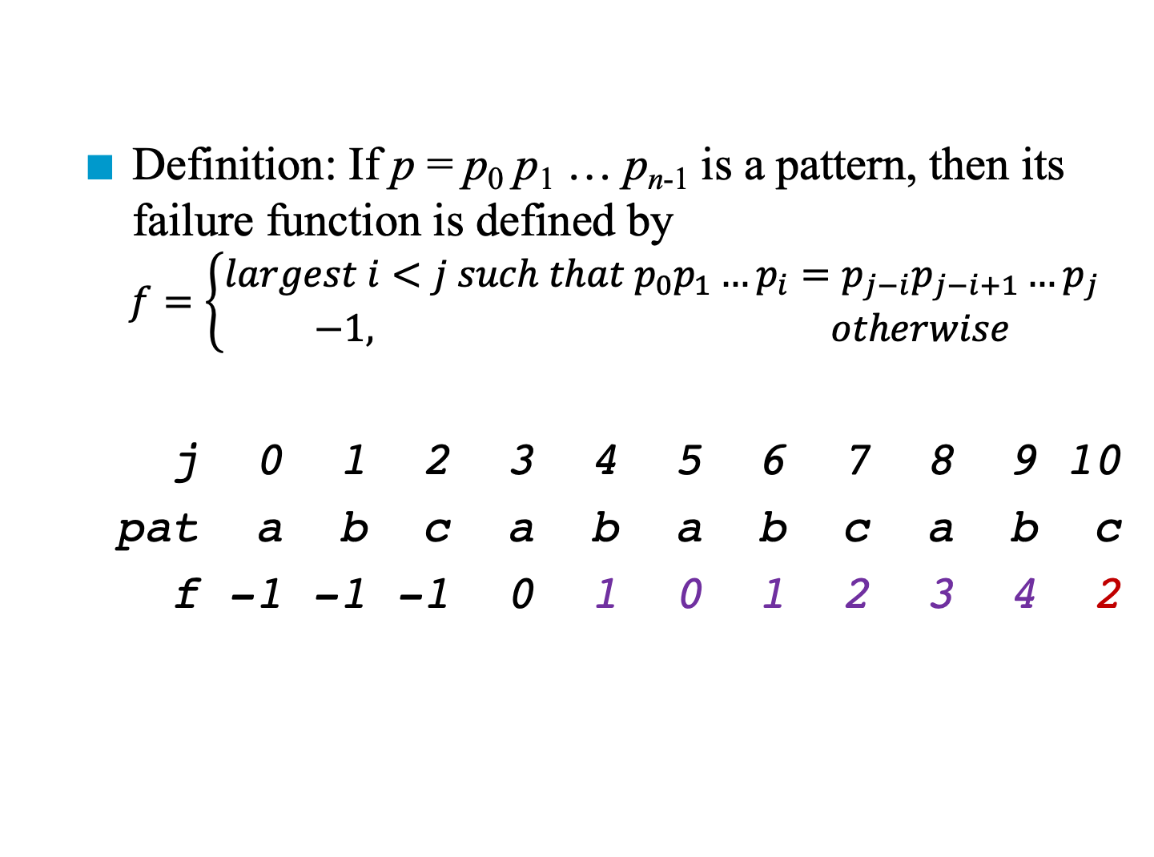
Prefix and Suffix
Definition: If p = p₀ p₁ … p_{n-1} is a pattern, then its failure function is defined by
$$f=\left\{\begin{aligned}largest i<j such that p_{0}p_{1}…p_{i}=p_{j−i}p_{j−i+1}…p_{j} \\ −1, otherwise\end{aligned}\right.$$
j 0 1 2 3 4 5 6 7 8 9 10
pat a b c a b a b c a b c
f -1 -1 -1 0 1 0 1 2 3 4 2
前綴
後綴

Slide 125
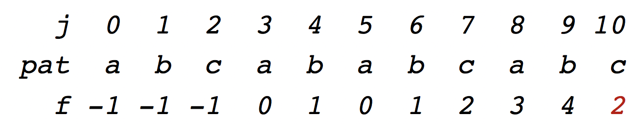
Build the Table
void fail(char *pat) { /* Compute the pattern’s failure function*/
int i, j, n = strlen (pat);
failure[0] = -1; for (j = 1; j < n; j ++){
i = failure[j-1];
while ((pat[j] != pat[i+1]) && (i >= 0))
i = failure[i];
if (pat[j] == pat[i+1]) // if i >= 0
failure[j] = i + 1;
else failure[j] = -1; // if i < 0
}
}
*Praogram 2.14: Knuth, Morris, Pratt pattern matching algorithm (p.96)

Slide 126
Build the Table
void fail(char *pat) { /* Compute the pattern’s failure function*/
int i, j, n = strlen (pat);
failure[0] = -1; for (j = 1; j < n; j ++){
i = failure[j-1];
while ((pat[j] != pat[i+1]) && (i >= 0))
i = failure[i];
if (pat[j] == pat[i+1]) // if i >= 0
failure[j] = i + 1;
else failure[j] = -1; // if i < 0
}
}
How many times j can be increased?
How many times i can be decreased?
*Praogram 2.14: Knuth, Morris, Pratt pattern matching algorithm (p.96)

Slide 127
Build the Table
void fail(char *pat) { /* Compute the pattern’s failure function*/
int i, j, n = strlen (pat);
failure[0] = -1; for (j = 1; j < n; j ++){
i = failure[j-1];
while ((pat[j] != pat[i+1]) && (i >= 0))
i = failure[i];
if (pat[j] == pat[i+1]) // if i >= 0
failure[j] = i + 1;
else failure[j] = -1; // if i < 0
}
}
How many times j can be increased?
O(strlen(pat))
How many times i can be decreased? O(strlen(pat))
*Praogram 2.14: Knuth, Morris, Pratt pattern matching algorithm (p.96)

Slide 128
Pattern Matching
Preprocessing (i.e., building the table): O(strlen(pat))
Pattern matching: O(strlen(string))
Total complexity: O(strlen(pat)+strlen(string))
It is not the best
More pattern matching algorithms http://www-igm.univ-mlv.fr/~lecroq/string/

